Slide 1


FINAL REPORT
Esta foto de Autor desconocido está bajo licencia CC BY-SA-NC
Juan Ignacio Alra
IBM Data Science Professional Certificate

Slide 2

Introduction Business Problem
A great man wants to build a Bar in Toronto and is searching a good place. I should help him to choose the better place.
This man have some interest to build a new Bar. He want to put his Bar near:
Stadium
Universities
Offices
He customer thinks these three locations guarantee a lot of people who want to go to a bar. We are going to use Foursquare information for recollect this information

Slide 3
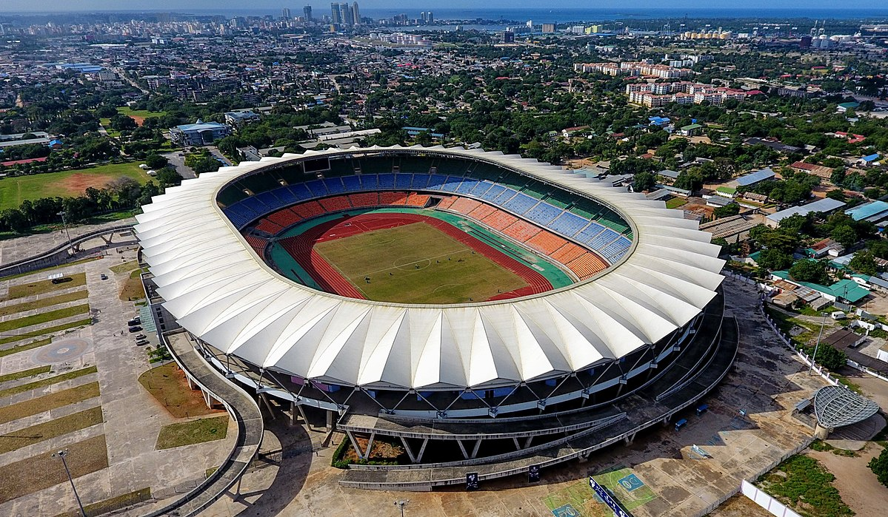
Data
We are using https://en.wikipedia.org/wiki/List_of_postal_codes_of_Canada:_M for the postal Canada in general and Neighbors and cities.
http://cocl.us/Geospatial_data For the Latitude and Longitude of Canada
The categories that we chose are
Stadium: 4bf58dd8d48988d184941735Universities: 4bf58dd8d48988d198941735
Offices: 4bf58dd8d48988d124941735
https://developer.foursquare.com/docs/resources/categories

Slide 4
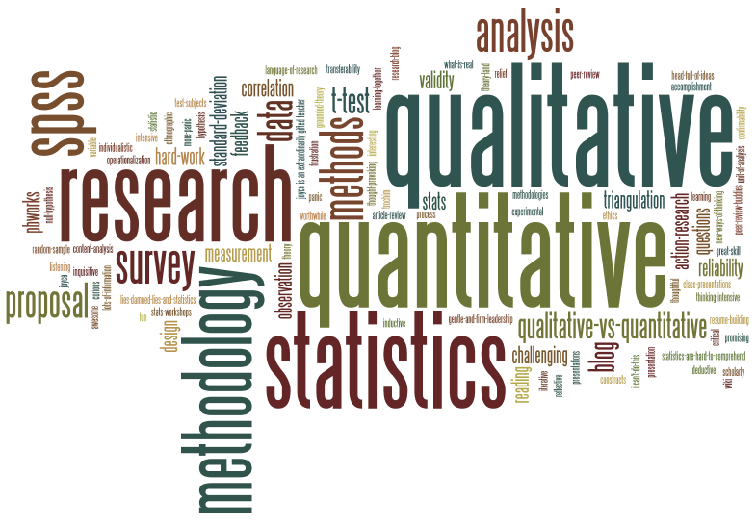
Methodology
We use beautiful Soup library to scrape an article on Wikipedia with the Toronto´s neighborhood.
We ordered the table and then import the geo data.
After that we use foursquare for the interest of the client about the Universities, Stadiums and Offices. Obviously, we add to the list the “Bars”.
Esta foto de Autor desconocido está bajo licencia CC BY-SA-NC

Slide 5
We define weights for each category, depending the taste of the client.
Universities = 3
Office = 3
Stadium = 1
We calculated the score of all of these categories and compare with the Bar and the better neighbor. The highest score determine the best place to put the Bar.

Slide 6

RESULT

Slide 7
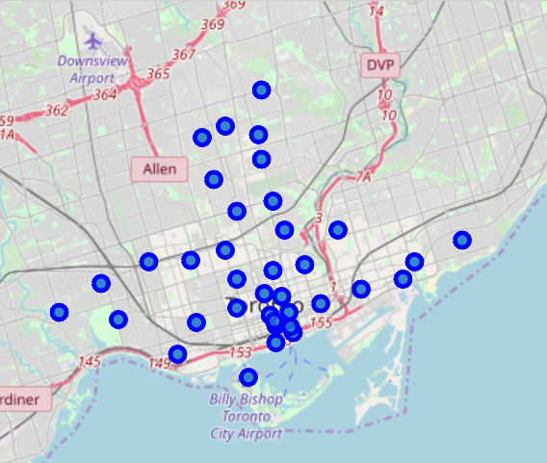
General Neighboor

Slide 8
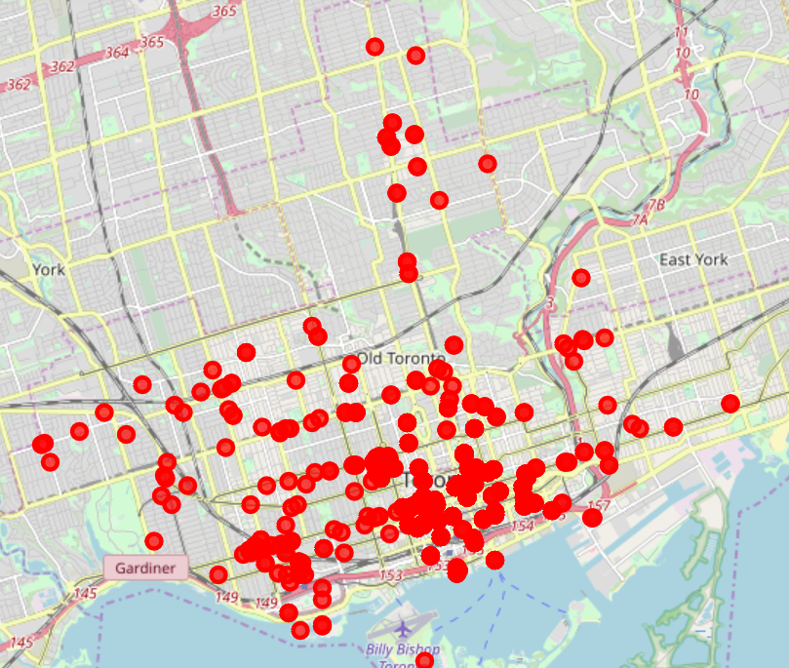
Bars in Toronto

Slide 9
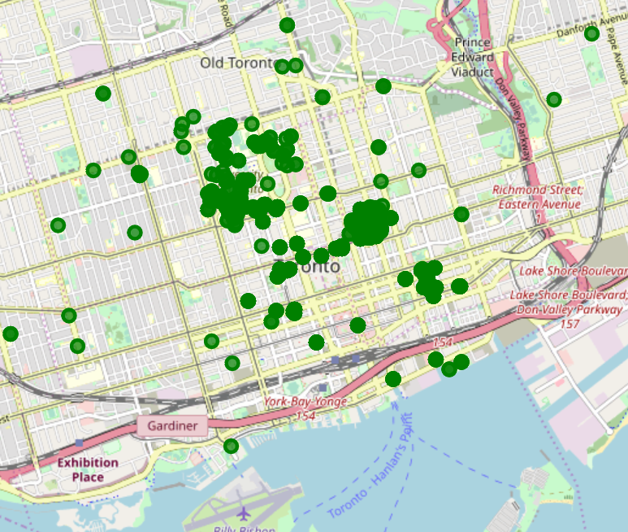
Universities in Toronto

Slide 10
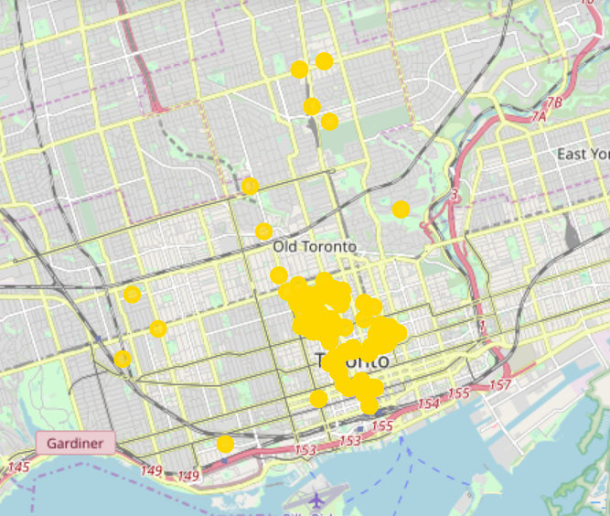
Stadium in Toronto

Slide 11
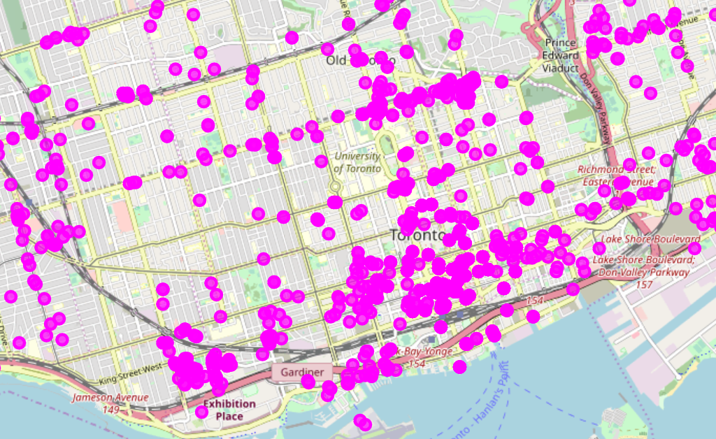
Office in Toronto

Slide 12
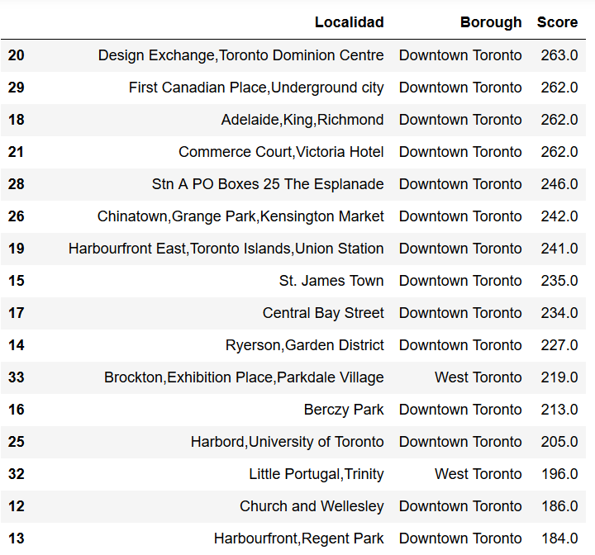
Final Score

Slide 13
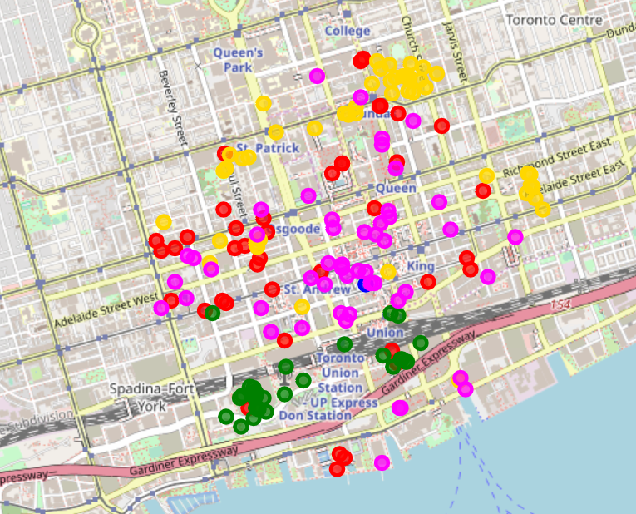
DISCUSS
Red = Another Bars
Green= Stadium
Fuchsia = Office
Yellow = Universities
Blue = Neighbor
The client have space for a Bar in this neighborhood (Blue) near the Office.
We could tip our filter for more specific bars if your customer wants different types of customers

Slide 14
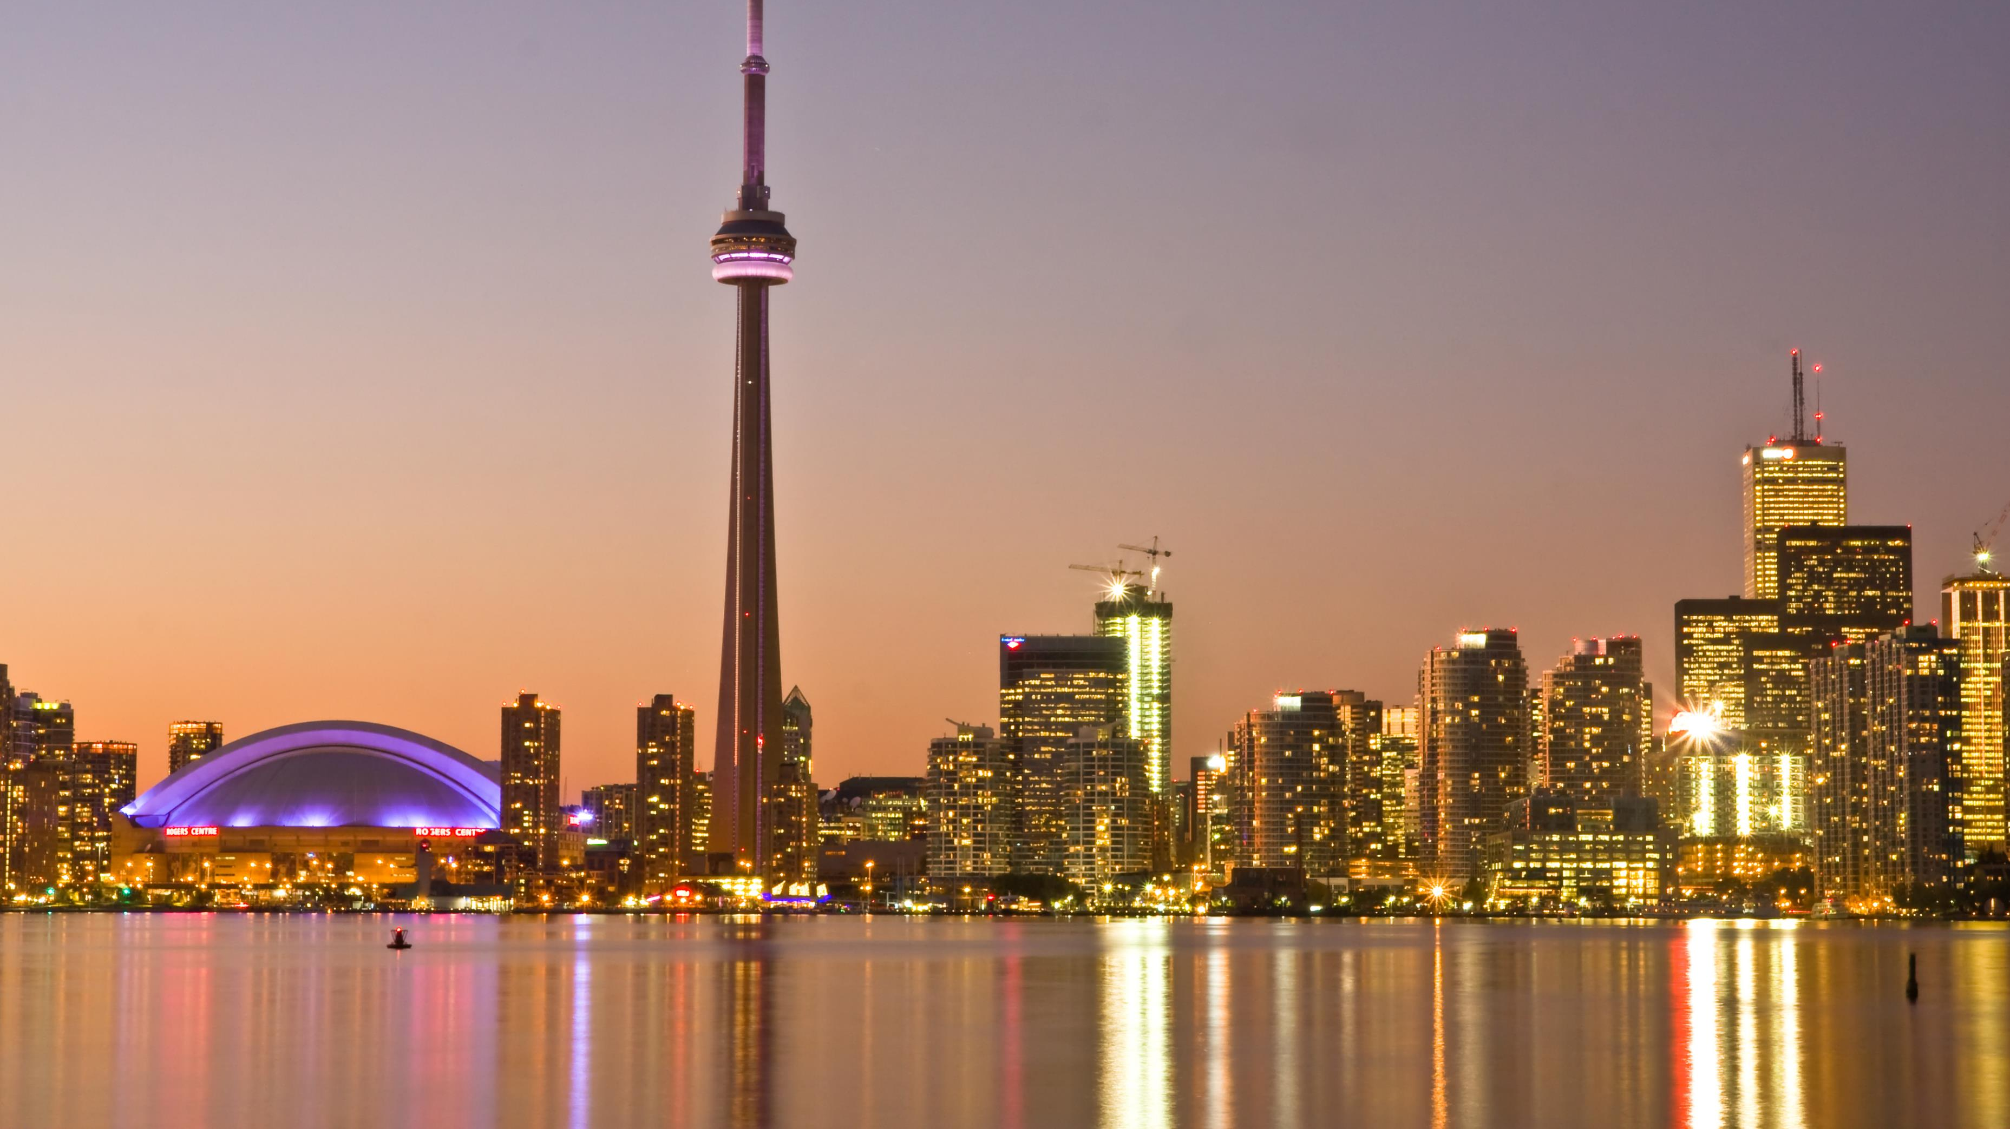
We hope that we helped our client with this analysis. We think we do.
Esta foto de Autor desconocido está bajo licencia CC BY-SA

